Slide 1
Welcome to RBA
R2RML By Assertions

Slide 2
Main Screen
Is divided into two parts:
  Contains a table with two columns: RDF Target and RDB Source. Each row represents a mapping Setup Configuration. And three buttons for create, edit and delete mapping setups.
  Has a Panel of Tabs. These tabs are ordered according to our semi-automatic process for generating R2RML (last tab) mappings based on the Design (first tab) of Correspondence Assertions.

Slide 3
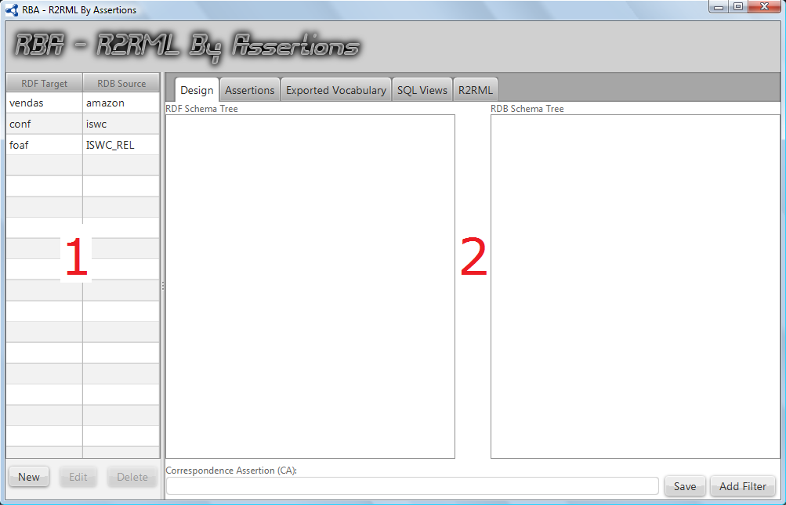
Main Screen

Slide 4
New Mapping Configuration
The creation of a new mapping configuration is the first task for the user.
This Task consists of choosing the Target RDF Vocabulary and the Source Relational Database Schema.

Slide 5
New Mapping Configuration
By clicking on “New” button, a new screen is loaded. This screen has two buttons “Cancel” and “Save” and an Accordion component.
Cancel button will close the screen.
Save button will persist the new configuration mapping into the repository and add it into the table of the main Screen.

Slide 6
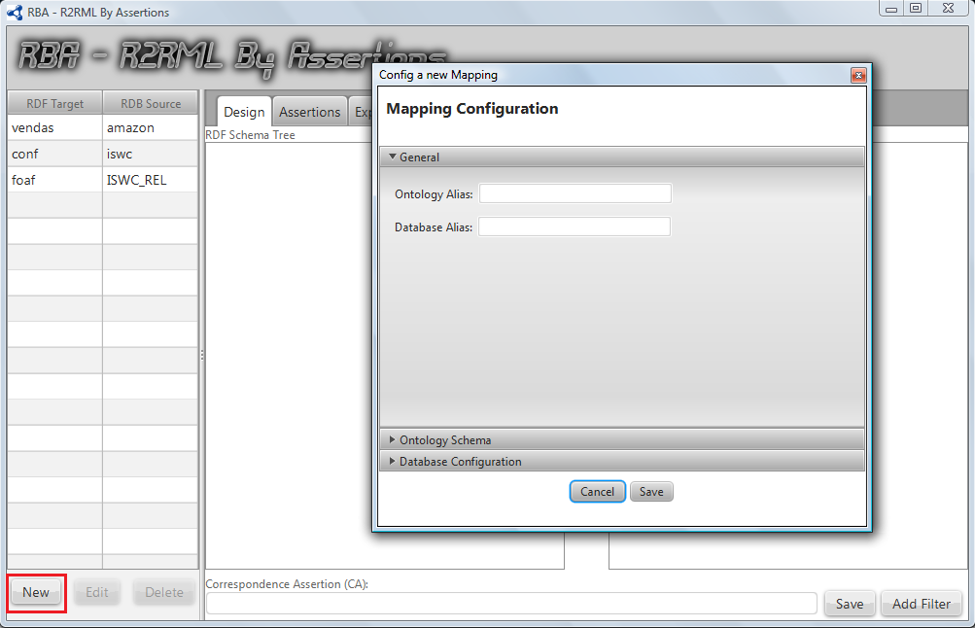
New Mapping Configuration

Slide 7
New Mapping Configuration
The Accordion component has three parts:
  The user will type an alias for the target ontology and for the source database;
  Defining a Ontology Schema that could be in a Local File or in a URL and choose the language used.
  Typing the parameters for connection with the Source Database.

Slide 8
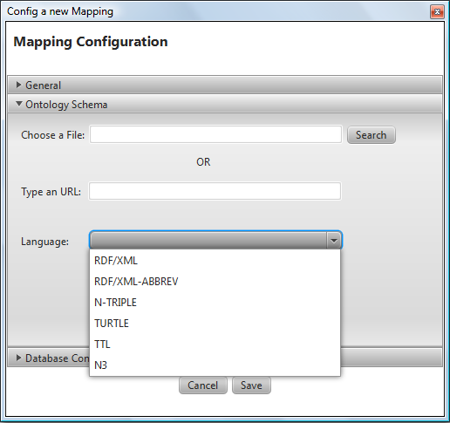
New Mapping Configuration

Slide 9
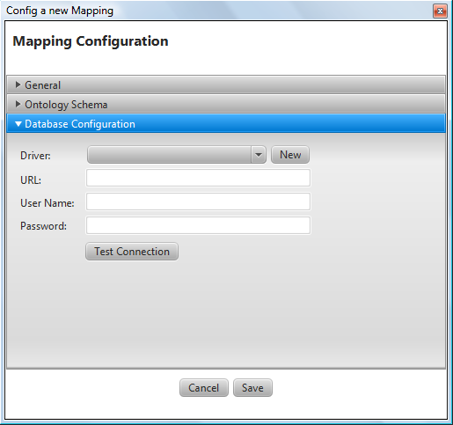
New Mapping Configuration

Slide 10
Design
This is the first Step of our process and is the only one who is not automatic.
After creating the initial configuration. A new line is added to our table at the left of the main screen.
By Double Clicking over the line, RBA loads the schemas into two trees located in Design Tab.

Slide 11
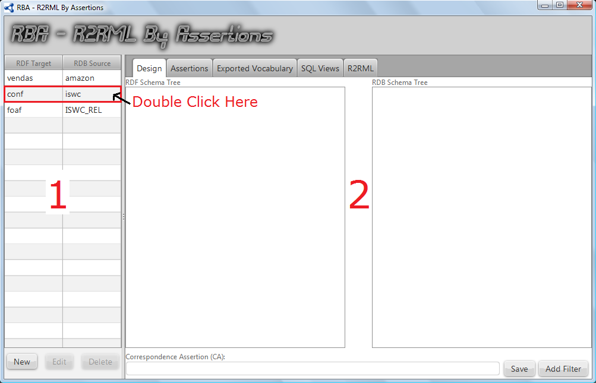
Design

Slide 12
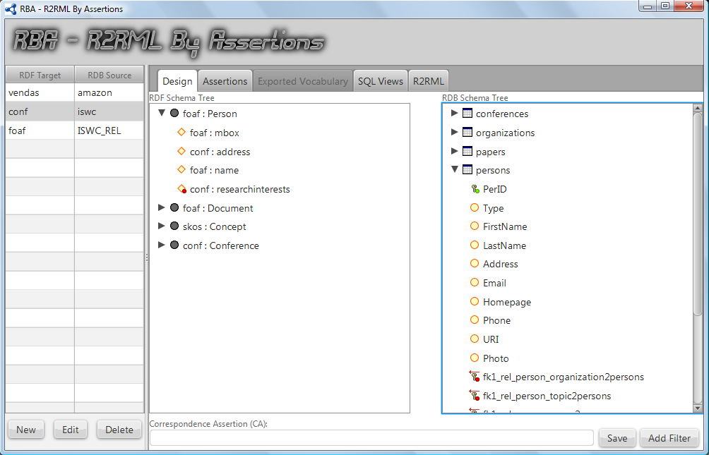
Design

Slide 13
Design
At this point, the user is able to create the correspondence assertions (CAs).
We defined three types of CAs:
  CCA that maps relations to classes and may contain a selection filter
  DCA that maps attributes to data properties and may contain fk paths.
  OCA that maps fks to object properties and also may contain fk paths.

Slide 14
Design
We will demonstrate the creation of each types of CA.
We create two CCAs in our example. One for class foaf:Person and another one for class foaf:Document.
The creation is very simple: the user just clicks on the node correspondent to the class

Slide 15
Design
The creation is very simple: the user just clicks on the node correspondent to the target class in Left Tree, clicks on the node correspondent to the relation source and on the selected attributes that will form the URI.
The CCA created is showed in a text field on the bottom.
The user must click on “Save” button to confirm the creation of the CCA.

Slide 16
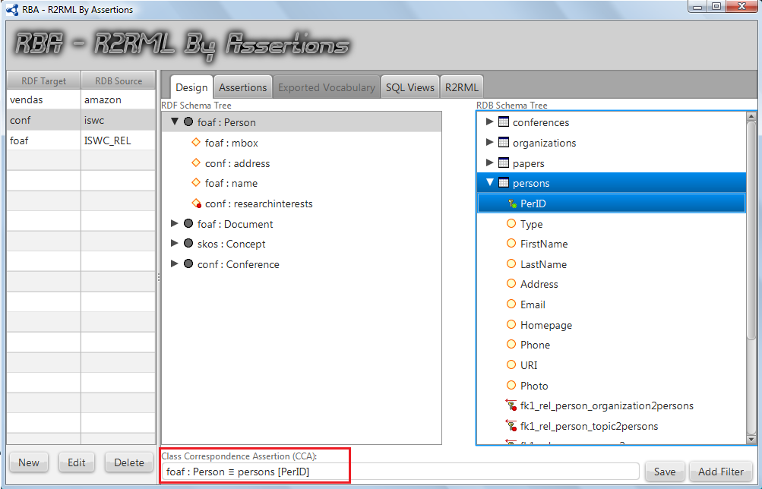
Design

Slide 17
Design
By clicking the “Save” button, RBA shows the list of assertions on second Tab updated with the last CA created.

Slide 18
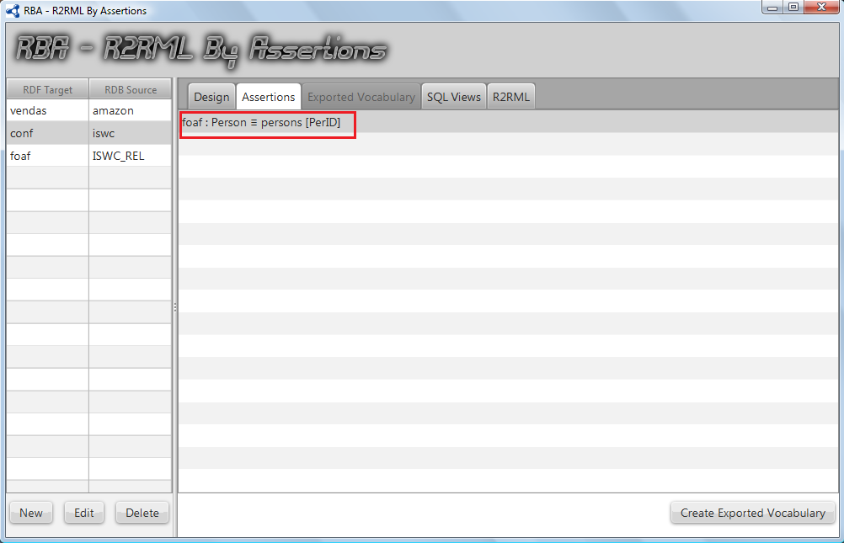
Design

Slide 19
Design
Optionally the user can define a Filter Condition when creating a CCA.
This is done by clicking the “Add Filter” button at the right bottom of “Design” Tab.

Slide 20
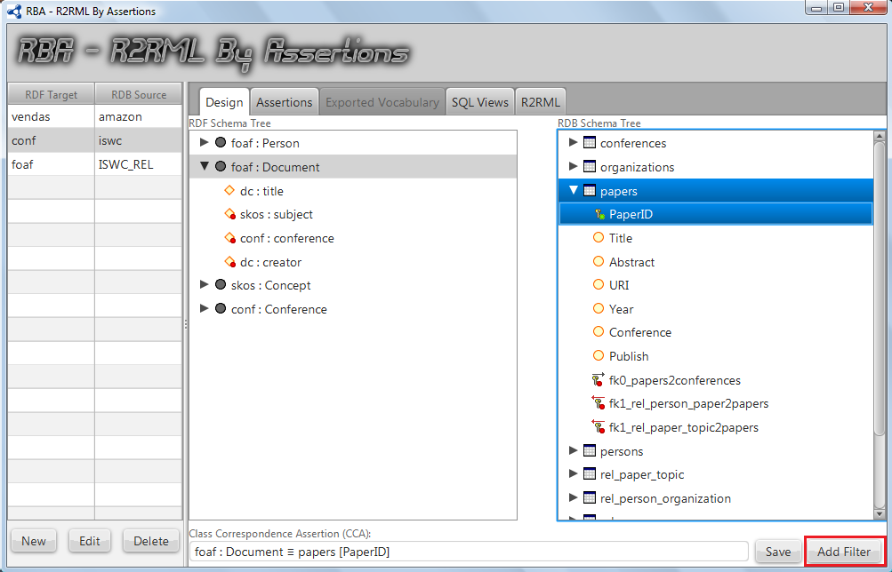
Design

Slide 21
Design
RBA loads a new screen so that the user can define the condition.
In our example we will select the papers published from 2010 to nowadays.

Slide 22
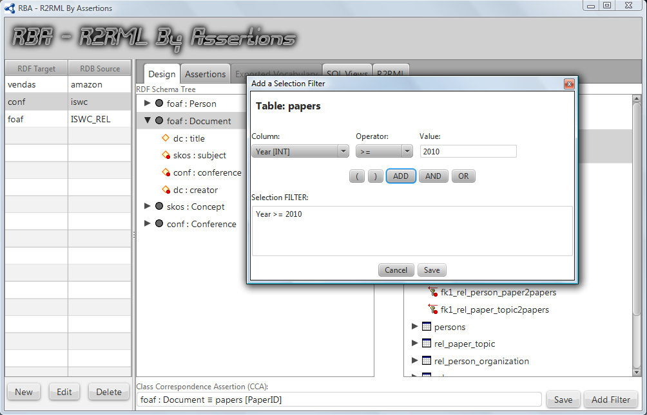
Design

Slide 23
Design
So the user clicks the “Save Button” and RBA updates the CCA with the Filter.

Slide 24
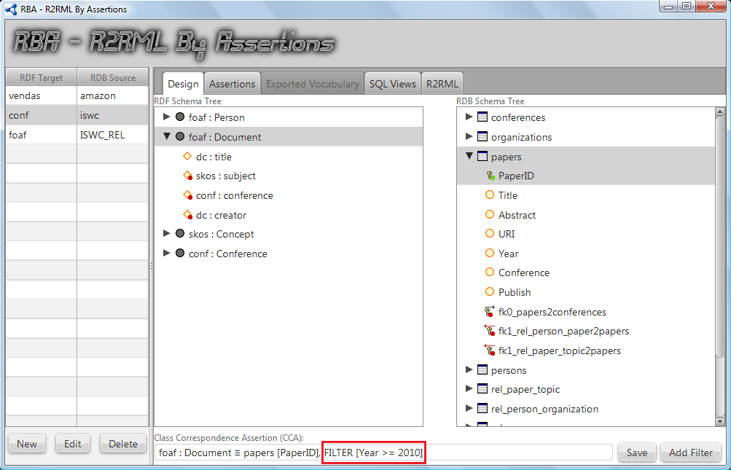
Design

Slide 25
Design
Again, user clicks the “Save Button” to save the CCA into the List.

Slide 26
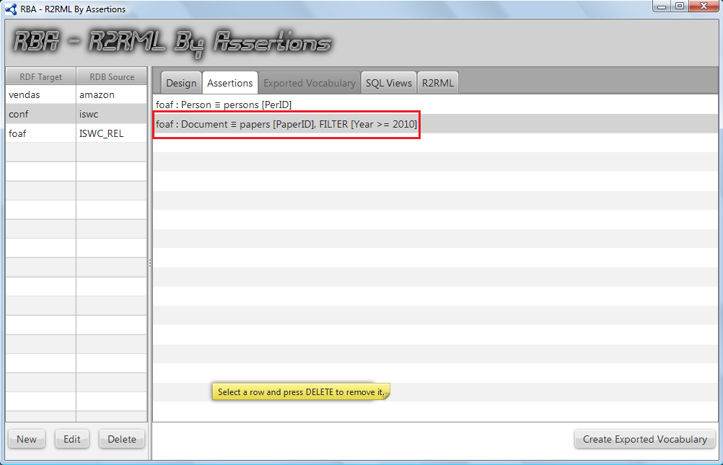
Design

Slide 27
Design
Now let’s create a DCA for mapping Email attribute to foaf:mbox data property.
The procedure is the same of creating a CCA.
The user just clicks on the correspondent terms and RBA creates the DCA and after clicking the “Save” button the assertion list is updated.

Slide 28
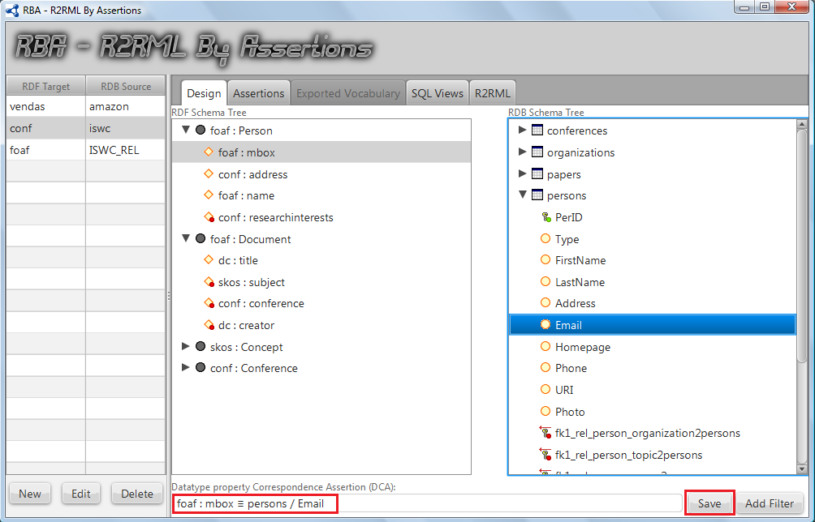
Design

Slide 29
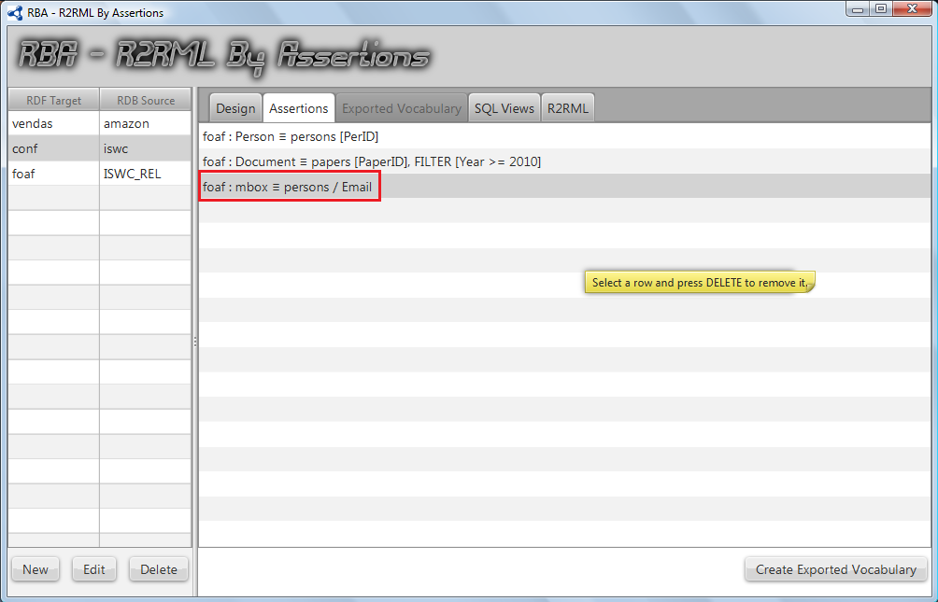
Design

Slide 30
Design
To finish the first step, let’s create an OCA that needs to define path of FKs.
In our target RDF vocabulary, class foaf:Document has object property dc:creator whose range is foaf:Person.
But there isn’t any fk that links directly relations persons and papers. Instead there is a link table rel_person_paper between them.

Slide 31
Design
So to create this OCA the user needs navigate between the FKs linking papers to rel_person_paper and rel_person_paper to persons.
By Double Clicking on the FK node in RDB Schema Tree, RBA loads the table referenced and their attributes and fks.
By clicking on a new FK, RBA updates the OCA to include it in the path.

Slide 32
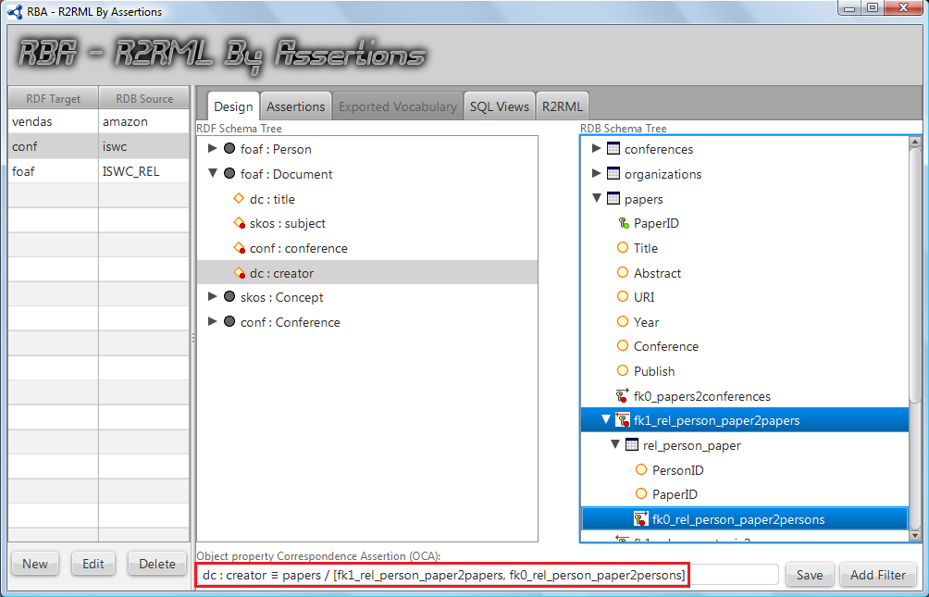
Design

Slide 33
Design
Again, by clicking on save button and the Assertions list is update.
The next step is generating the exported vocabulary.
This is automatically done, the user just clicks the “Create Exported Vocabulary” button and RBA shows the exported vocabulary in its correspondent Tab.

Slide 34
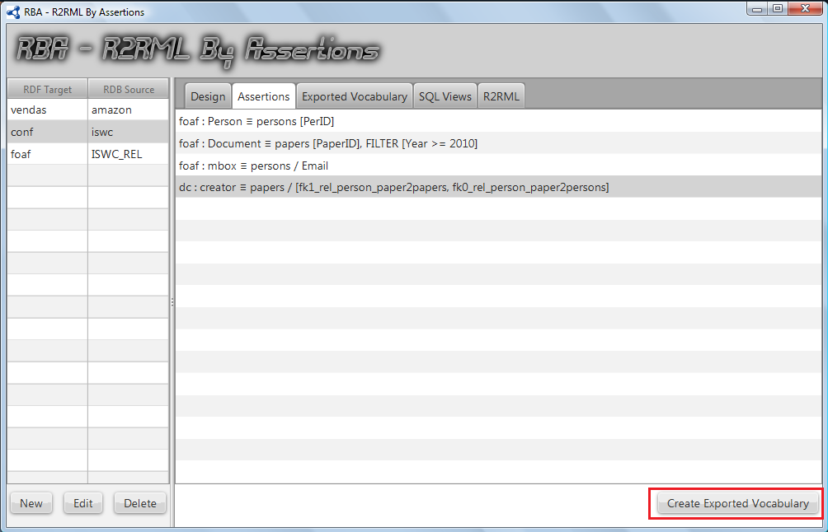
Design

Slide 35
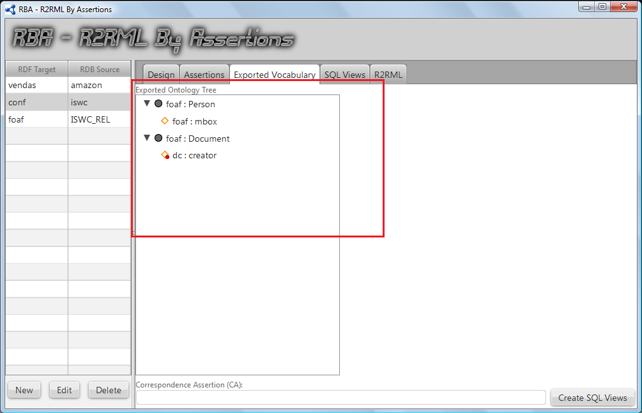
Exported Vocabulary

Slide 36
Exported Vocabulary
Viewing the EO is important for checking if all classes and properties needed were included.
The next step is “Create SQL Views”. These views will map the Source RDB Schema in terms of the EO.
Again the user just clicks in a Button and RBA shows the Views into the next Tab.

Slide 37
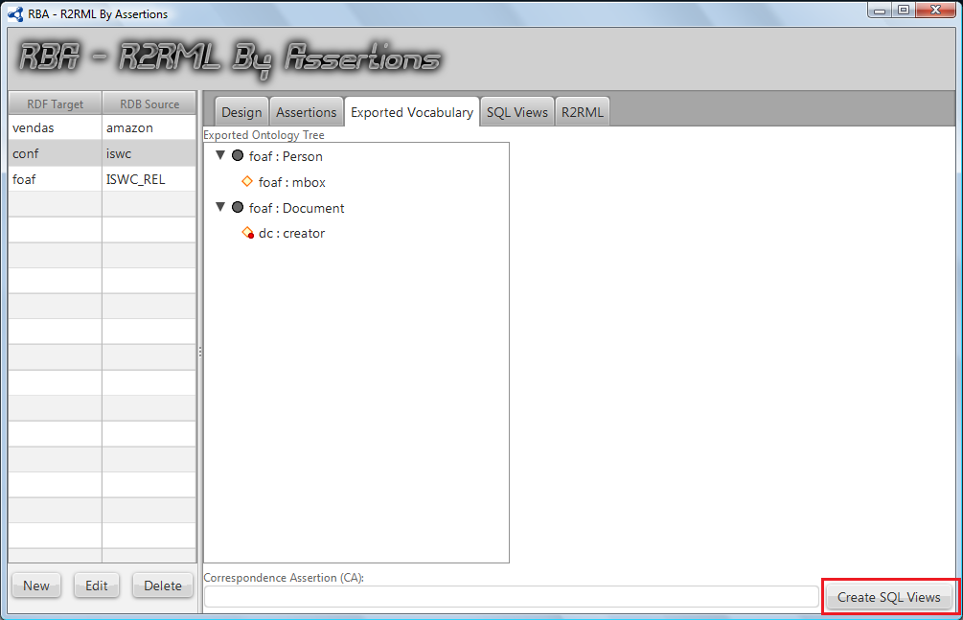
Exported Vocabulary

Slide 38
SQL Views
For our example, RBA creates three SQL Views: one for mapping the class foaf:Person (Person_View), a second one for mapping the class foaf:Document (Document_View) and a third one for mapping the object property dc:creator (Document_Creator_View) that belongs to class foaf:Document.

Slide 39
SQL Views
The third View (Document_Creator_View) is necessary because the cardinality of dc:creator is greater than 1 and it was necessary to create a FK path for its mapping.

Slide 40
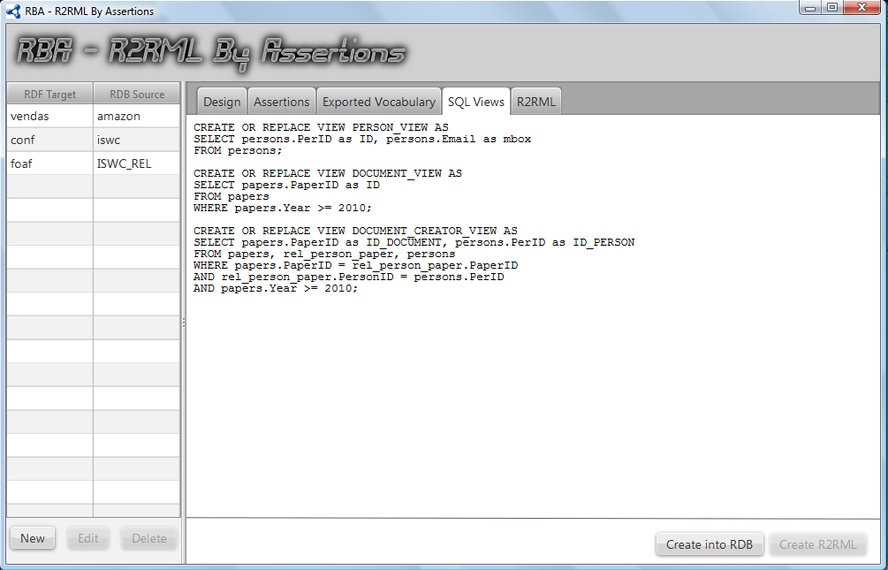
SQL Views

Slide 41
SQL Views
Looking to the SQL Views we can note that the FILTER created was included in View Document_View and propagated to View Document_Creator_View;

Slide 42
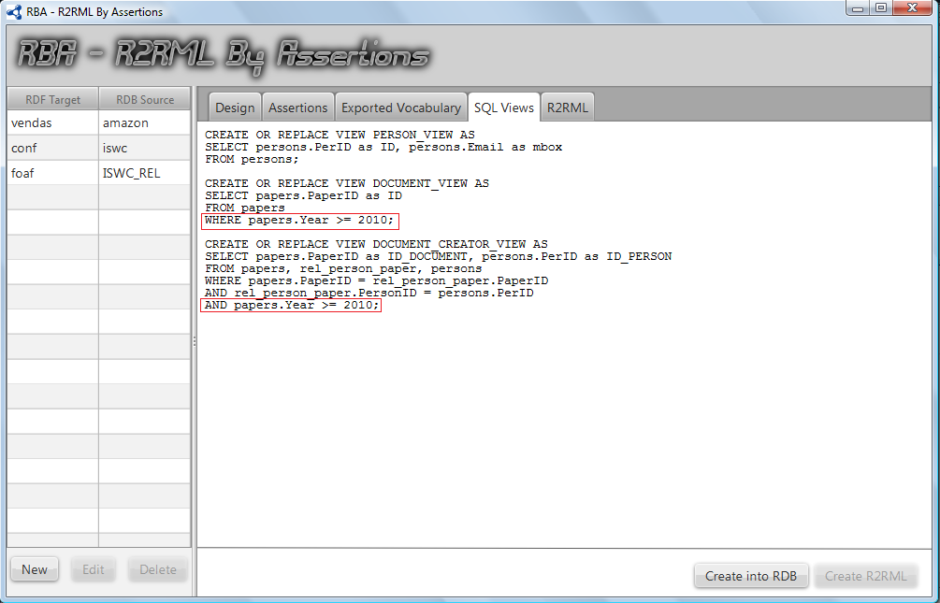
SQL Views

Slide 43
SQL Views
When the user demands by clicking a button again, RBA creates all the Views into the Source Database and the Button “Create R2RML” is enabled;

Slide 44
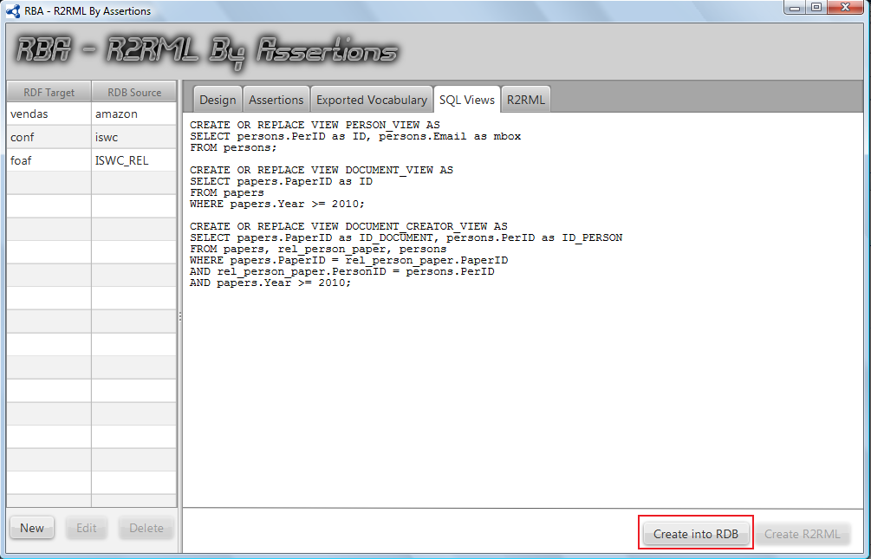
SQL Views

Slide 45
SQL Views
The User can check if the creation was successfully done just double clicking into the mapping configuration line again. The RDB Tree will be reloaded with the three Views added.

Slide 46
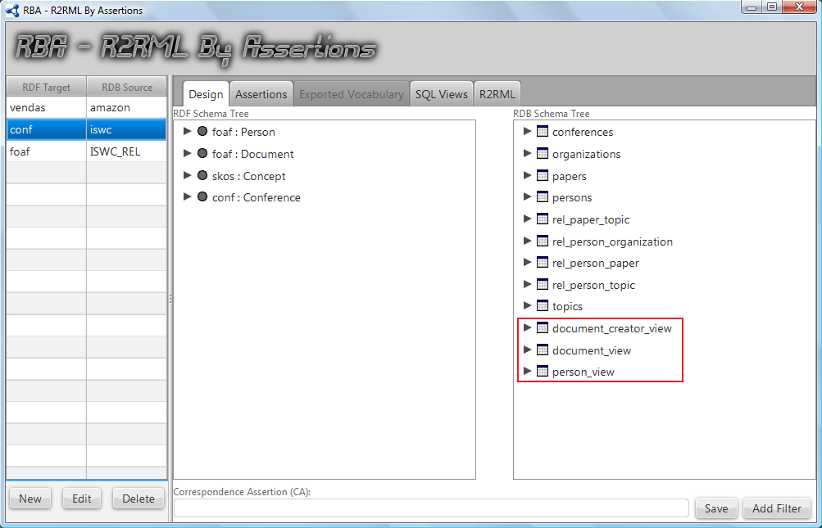
SQL Views

Slide 47
R2RML
The last Step is accomplished when user clicks the button “Create R2RML”.
RBA shows the final mapping generated. This mapping uses the Views just created as Logical Tables.

Slide 48
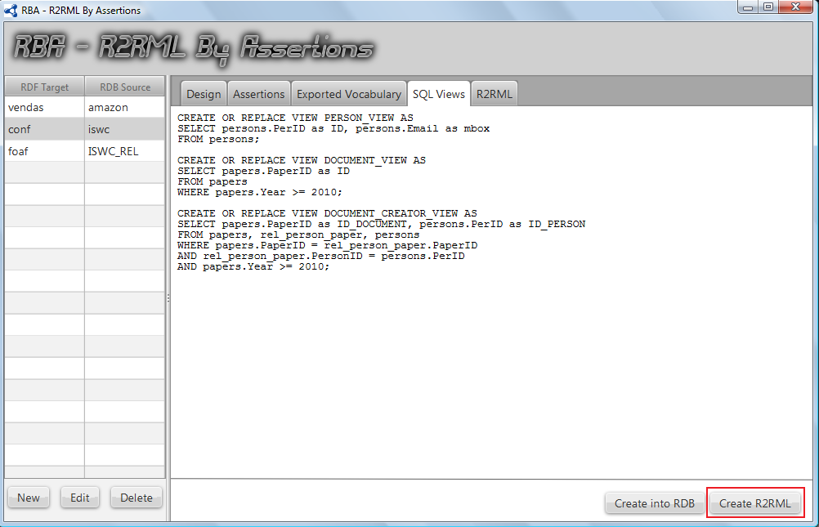
SQL Views

Slide 49
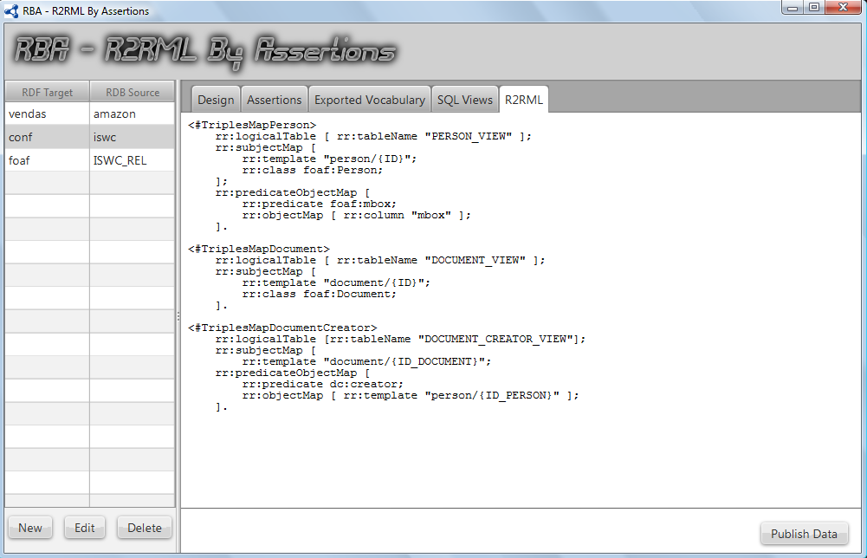
SQL Views

Slide 50
R2RML
As the Views done all the hard work handling the heterogeneity problems, the final mapping is very simple.
It just creates one TriplesMap for each View.

